Slide 1
Data Structure and Algorithms
(CS212)
Instructor : Dr. Syed Musharaf Ali
musharaf.ali@iiu.edu.pk

Slide 2
Sorting
Sorting is the process of arranging a list of elements in a particular order (Ascending or Descending).
Sorting arranges data in a sequence which makes searching easier.
There are many types of Sorting techniques, differentiated by their efficiency and space requirements. Following are some sorting techniques
Bubble Sort
Insertion Sort
Selection Sort
Merge Sort
Shell Sort
Quick Sort

Slide 3
Bubble Sort
In bubble sort each pair of adjacent elements is compared and the elements are swapped if they are not in order.
It is called Bubble sort, because with each iteration the largest element in the list bubbles up towards the last place, just like a water bubble rises up to the water surface.
This algorithm is not suitable for large data sets as its average and worst case complexity are of Ο(n²) where n is the number of items.

Slide 4
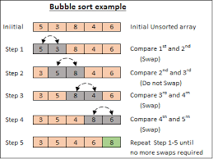
Bubble Sort
Example 1:

Slide 5
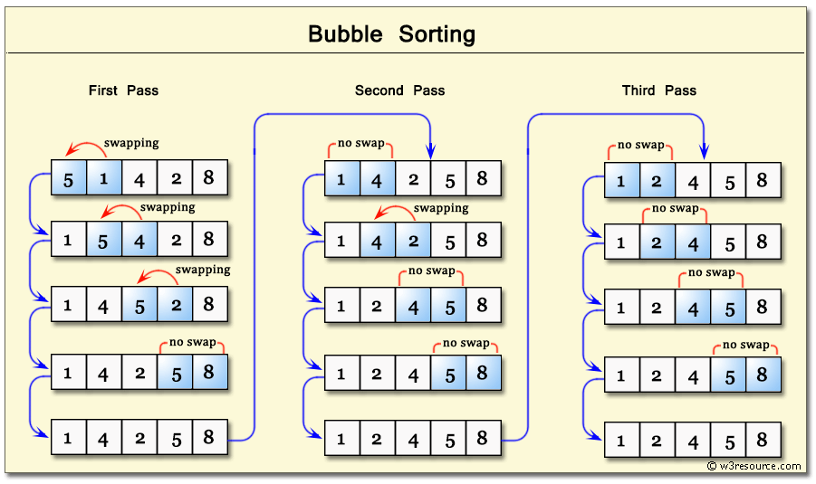
Bubble Sort
Example 2:

Slide 6
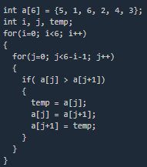
Bubble Sort
Algorithm:
Let's consider an array with values {5, 1, 6, 2, 4, 3}

Slide 7
Bubble Sort
Complexity Analysis of Bubble Sort:
In Bubble Sort, n-1 comparisons will be done in 1st pass,
n-2 in 2nd pass,
n-3 in 3rd pass and so on.
So the total number of comparisons will be
(n-1)+(n-2)+(n-3)+.....+3+2+1
Sum = n(n-1)/2
Worst case time complexity = O(n^2)
Link: http://www.studytonight.com/data-structures/bubble-sort

Slide 8
Insertion Sort
In insertion sort algorithm, list is divided into two portions,
(1) sorted, (2) unsorted.
Every iteration moves an element from unsorted portion to sorted portion until all the elements are sorted in the list.

Slide 9
Insertion Sort
The insertion sort algorithm is performed using following steps...
Step 1: Assume that first element in the list is in sorted portion of the list and remaining all elements are in unsorted portion.
Step 2: Consider first element from the unsorted list and insert that element into the sorted list in order specified.
Step 3: Repeat the above process until all the elements from the unsorted list are moved into the sorted list.

Slide 10
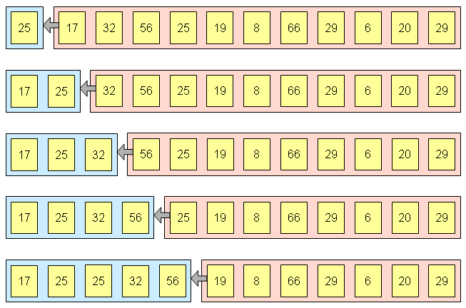
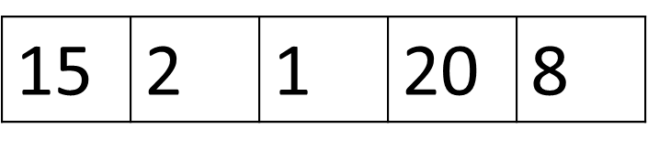
Insertion Sort
Example 1:

Slide 11
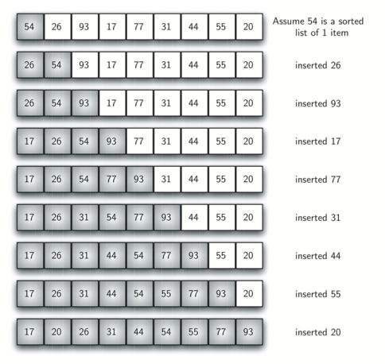
Insertion Sort
Example 2:

Slide 12
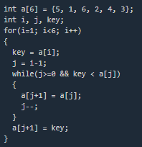
Insertion Sort
Algorithm:
This algorithm is not suitable for large data sets as its average and worst case complexity are of Ο(n²), where n is the number of items.

Slide 13
Selection Sort
In selection sort, the first element in the list is selected and it is compared repeatedly with remaining all the elements in the list.
If any element is smaller than the selected element (for Ascending order), then both are swapped.
Then we select the element at second position in the list and it is compared with remaining all elements in the list. If any element is smaller than the selected element, then both are swapped.
This procedure is repeated till the entire list is sorted.
This algorithm is not suitable for large data sets as its average and worst case complexities are of Ο(n²), where n is the number of items.

Slide 14
Selection Sort
The selection sort algorithm is performed using following steps...
Step 1: Select the first element of the list (i.e., Element at first position in the list).
Step 2: Compare the selected element with all other elements in the list.
Step 3: For every comparison, if any element is smaller than selected element (for Ascending order), then these two are swapped.
Step 4: Repeat the same procedure with next position in the list till the entire list is sorted.

Slide 15
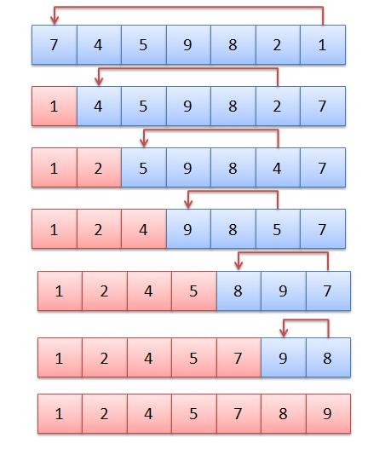
Selection Sort
Example 1:

Slide 16
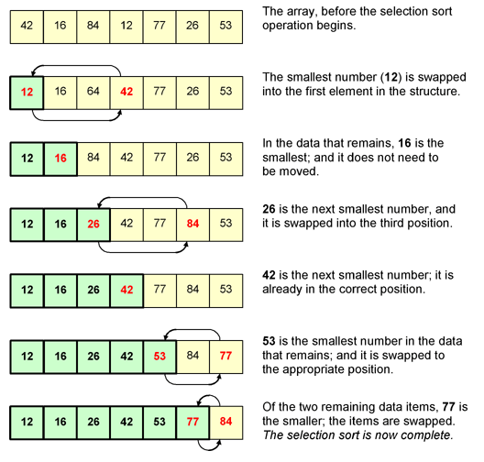
Selection Sort
Example 2:

Slide 17
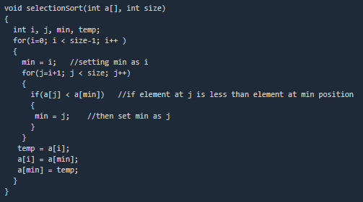
Selection Sort
Algorithm:
This algorithm is not suitable for large data sets as its average and worst case complexities are of Ο(n²), where n is the number of items.

Slide 18
Sort
Links:
http://btechsmartclass.com/DS/U4_T4.html
http://www.studytonight.com/data-structures/introduction-to-sorting
https://www.tutorialspoint.com/data_structures_algorithms/sorting_algorithms.htm

Slide 19
Merge Sort
Merge sort is a sorting technique based on divide and conquer technique.
It divides input array in two halves, calls itself for the two halves and then merges the two sorted halves.
With worst-case time complexity being Ο(n log n), it is one of the most respected algorithms.
https://www.geeksforgeeks.org/merge-sort/

Slide 20
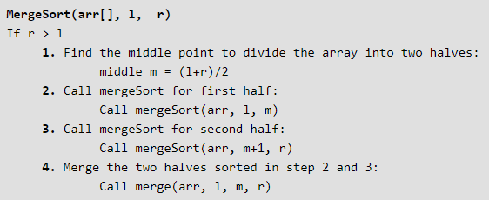
Merge Sort
Algorithm:
r is the length of an array

Slide 21
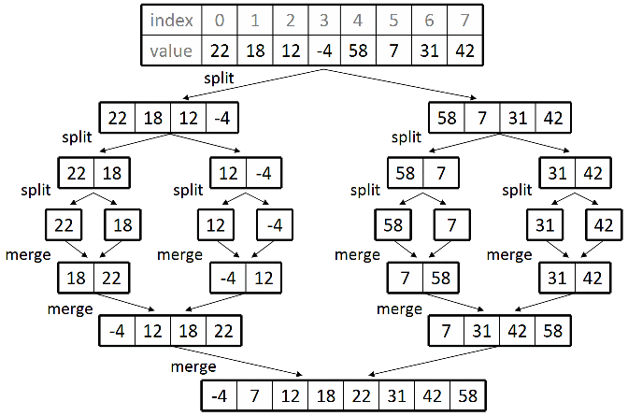
Merge Sort
Example 1:

Slide 22
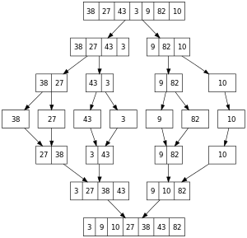
Merge Sort
Example 2:

Slide 23
Quick Sort
Quick sort is a highly efficient sorting algorithm and is based on partitioning of array of data into smaller arrays.
It is based on the rule of Divide and Conquer.
This algorithm divides the list into three main parts :
Elements less than the Pivot element
Pivot element(Central element)
Elements greater than the pivot element
Pivot element can be the leftmost, rightmost or central element of the list
Time complexity is O(n^2)

Slide 24
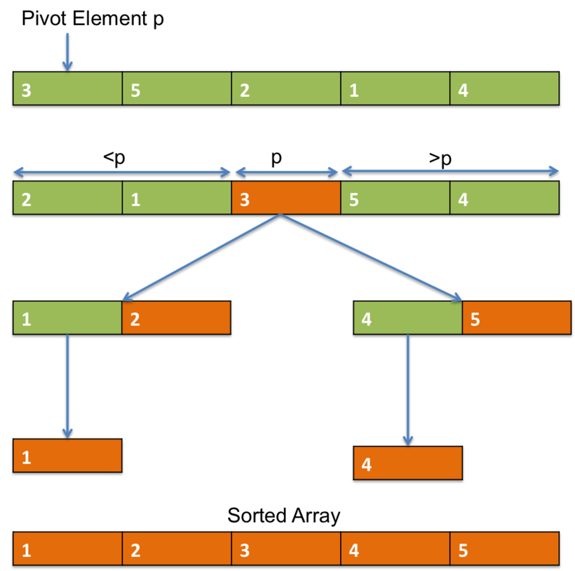
Quick Sort
Example 1:

Slide 25
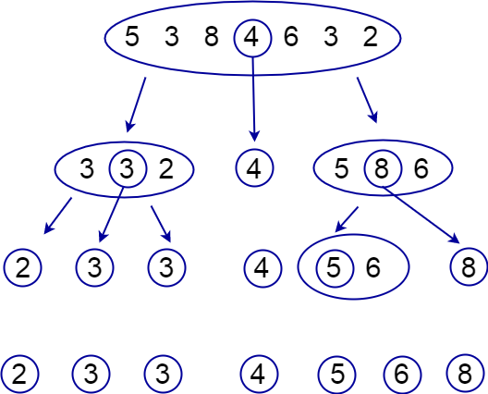
Quick Sort
Example 2:

